Slide 1
Lecture 1
Prepared By Engr. Amna Shaikh
APPLIED PHYSICS

Slide 2
WHAT IS PHYSICS
Physics is a fundamental branch of science that studies matter, energy, space, time, and the interactions between them. It seeks to understand how the universe works, from the smallest subatomic particles to the largest galaxies, using observation, experiments, and mathematical models.

Slide 3
From Where Did Physics Emerge?
Physics emerged from natural philosophy in ancient civilizations, where humans tried to understand natural phenomena such as motion, light, sound, heat, and the stars.
Historical development:
Ancient civilizations (Greek, Egyptian, Indian, Chinese): Early ideas about motion, atoms, and astronomy
  Example: Aristotle (motion and matter)
Islamic Golden Age: Experimental methods and optics
  Example: Ibn al-Haytham (optics and scientific experimentation)
Classical era (17th century): Physics became a formal science
  Example: Isaac Newton (laws of motion and gravitation)
Modern era (19th–20th century): Expansion into electromagnetism, relativity, and quantum mechanics
  Example: Einstein, Maxwell, Planck
Thus, physics evolved as humans sought systematic and mathematical explanations of nature.

Slide 4
Types (Branches) of Physics
Physics is broadly divided into two main categories, with several sub-branches:
1. Classical Physics
Deals with macroscopic objects and low speeds.
Mechanics – Motion and forces
Thermodynamics – Heat and energy
Waves and Acoustics – Sound and vibrations
Optics – Light and vision
Electromagnetism – Electricity and magnetism

Slide 5
Continue
2. Modern Physics
Deals with microscopic and high-speed phenomena.
Quantum Mechanics – Atomic and subatomic particles
Relativity – Space, time, and gravity at high speeds
Atomic Physics
Nuclear Physics
Particle Physics
Solid State / Condensed Matter Physics

Slide 6
Role of Applied Physics
Applied physics focuses on using physical principles to analyze and solve real-world problems. It is not separate from physics; rather, it draws from both classical and modern physics depending on the system under study.
Systems governed by mechanics, waves, thermodynamics, and electromagnetism rely on classical physics.
Systems involving atomic structure, radiation, electronic materials, and spectroscopy rely on modern physics.
Thus, applied physics acts as a link between theory and practical systems.

Slide 7
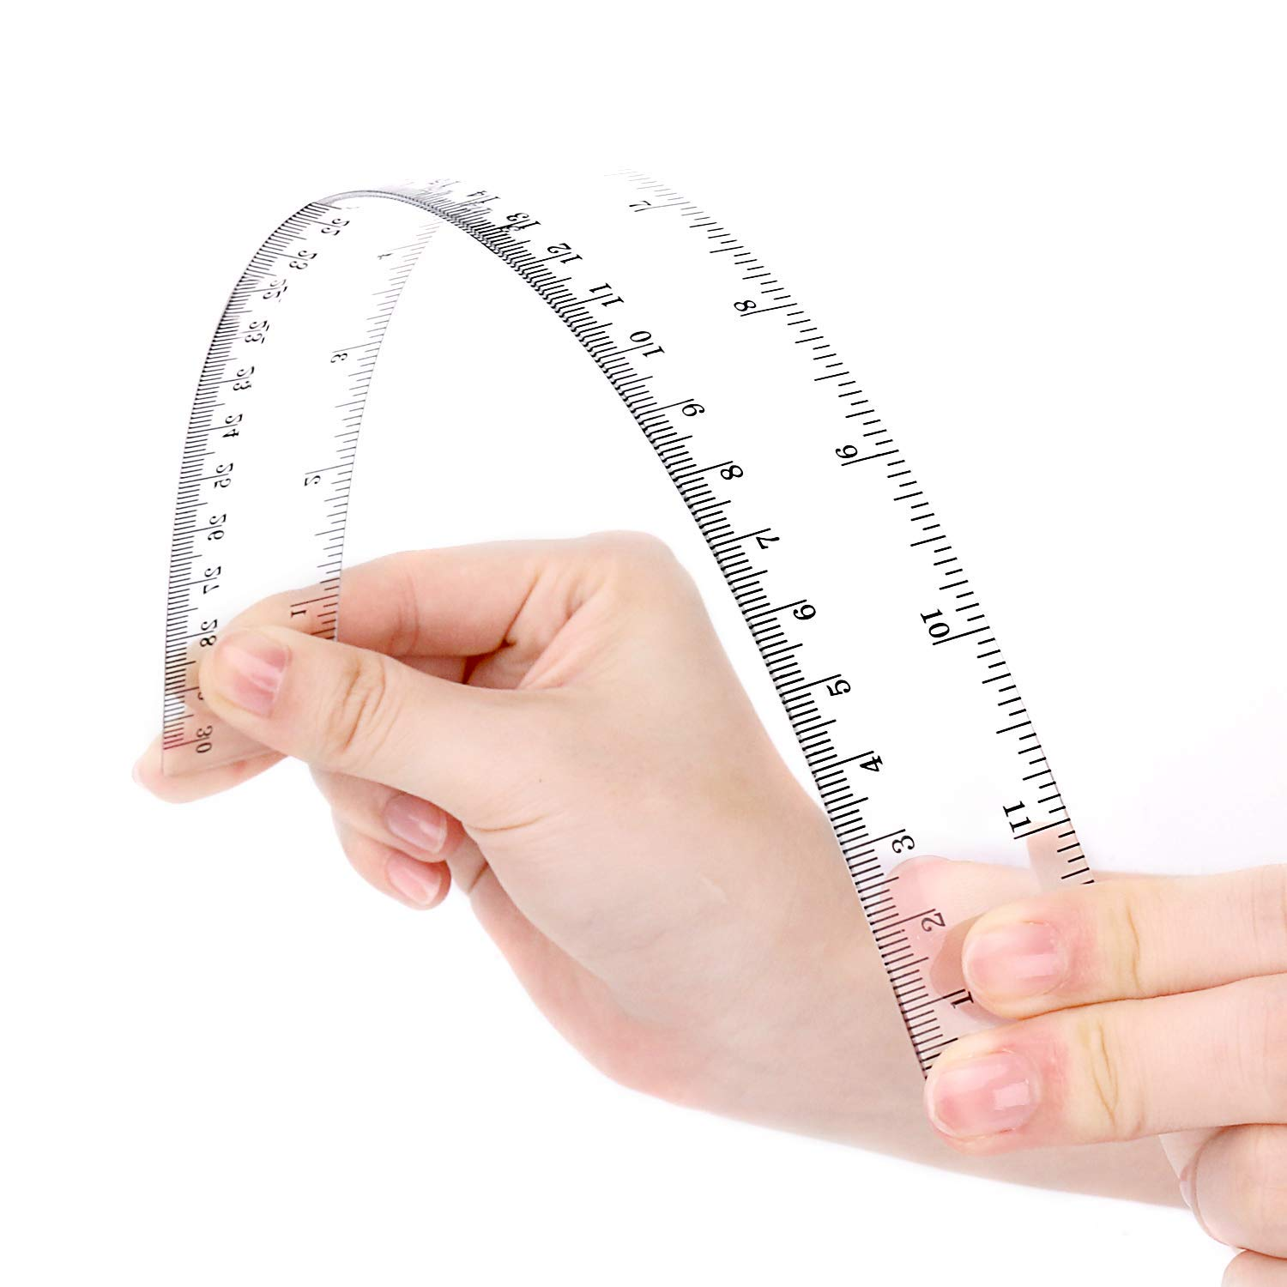

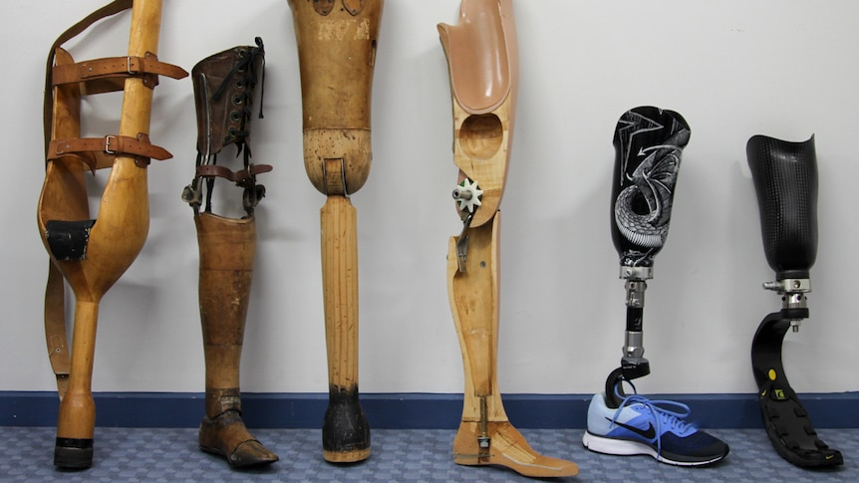
Properties of Matter
Why do bridges not collapse under load?
Why does a ruler bend but not break?
Why are prosthetics designed using specific materials?
Ans: Properties of matter describe how materials respond when forces act on them.

Slide 8
Properties of matter describe how a material behaves when forces, heat, electricity, or light act on it.
Classification
Mechanical
Physical
Thermal
Electrical
Magnetic
Optical
Chemical

Slide 9
Physical Properties
Physical Property | Meaning | Example
Density | Mass per unit volume | Iron is denser than wood
Color | Visual appearance | Copper is reddish-brown
State | Solid, liquid, gas | Water → ice / liquid / steam
Melting Point | Temperature at which solid melts | Ice melts at 0°C
Boiling Point | Temperature at which liquid boils | Water boils at 100°C
Electrical Conductivity | Ability to conduct electricity | Copper conducts electricity
Thermal Conductivity | Ability to conduct heat | Metals conduct heat well
Solubility | Ability to dissolve | Salt dissolves in water

Slide 10
Thermal Property
Thermal Property | Meaning | Example
Thermal Conductivity | Ability to conduct heat | Copper
Heat Capacity | Heat required to raise temperature | Water
Thermal Expansion | Change in size with temperature | Railway tracks
Specific Heat | Heat required per unit mass | Aluminum
Thermal Resistance | Resistance to heat flow | Insulating materials

Slide 11
Electrical Properties of Matter
Electrical Property | Meaning | Example
Electrical Conductivity | Ability to conduct electric current | Copper
Resistivity | Resistance to electric current | Rubber
Dielectric Strength | Ability to withstand electric field | Insulators
Permittivity | Ability to store electric charge | Capacitors
Semiconductivity | Partial conductivity | Silicon

Slide 12
Magnetic Properties of Matter
Magnetic Property | Meaning | Example
Diamagnetism | Weak repulsion by magnetic field | Copper
Paramagnetism | Weak attraction by magnetic field | Aluminum
Ferromagnetism | Strong attraction | Iron
Magnetic Permeability | Ability to support magnetic field | Iron core
Hysteresis | Lag between magnetization & field | Transformers

Slide 13
Optical Properties of Matter
Optical Property | Meaning | Example
Reflection | Bouncing back of light | Mirror
Refraction | Bending of light | Glass prism
Absorption | Light energy absorbed | Black surface
Transparency | Allows light to pass | Glass
Opacity | Blocks light | Wood
Refractive Index | Speed change of light in medium | Optical fibers

Slide 14
Chemical Properties of Matter
Chemical Property | Meaning | Example
Corrosion Resistance | Resistance to chemical damage | Stainless steel
Oxidation | Reaction with oxygen | Rusting
Reactivity | Tendency to react chemically | Sodium
Flammability | Ability to catch fire | Petrol
Chemical Stability | Resistance to decomposition | Gold

Slide 15
Mechanical Properties
Mechanical Property | Meaning | Example
Elasticity | Ability to regain original shape after deformation | Steel spring
Plasticity | Ability to undergo permanent deformation | Clay
Strength | Ability to withstand applied load | Structural steel
Stiffness | Resistance to deformation | Bone
Ductility | Ability to be drawn into wires | Copper
Malleability | Ability to be hammered into sheets | Gold
Hardness | Resistance to scratching or indentation | Diamond
Toughness | Ability to absorb energy before fracture | Rubber
Brittleness | Tendency to break without deformation | Glass

Slide 16
Quick Summary
Property Type | Key Focus
Mechanical | Behavior under force
Physical | Observable characteristics
Thermal | Response to heat
Electrical | Response to electric field
Magnetic | Response to magnetic field
Optical | Interaction with light
Chemical | Reaction behavior

Slide 17

Elasticity
Elasticity is the ability of a material to return to its original shape after the removal of an applied force.
Key Points:
Deformation occurs due to force
Shape recovers when force is removed
Valid within elastic limit
Takeaway: Elastic materials store energy temporarily.

Slide 18
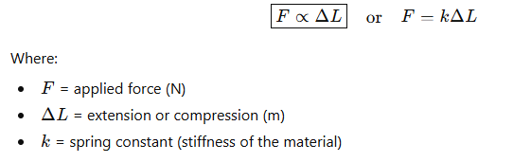
Hook’s Law
Definition:
Hooke’s Law states that, within the elastic limit, the deformation (stretch or compression) of a body is directly proportional to the applied force.
In simple words:
“Stretch a spring a little → it stretches proportionally. Pull twice as hard → it stretches twice as much.”
Formula:
Elastic Limit
Hooke’s Law is valid only up to the elastic limit.
Beyond that, the material may permanently deform (plastic deformation).

Slide 19

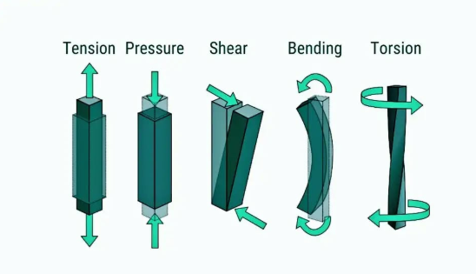
Stress
Different Types of Stresses in Materials
1. Tensile Stress: Stress that tends to stretch a material, caused by axial pulling force.
2. Compressive Stress: Stress that compresses or shortens a material, caused by axial pushing force.
3. Shear Stress: Stress that acts parallel to the surface, causing layers to slide against each other.
4. Bending Stress: Stress developed when a beam is subjected to bending moment, causing tension on one side and compression on the other.
5. Torsional Stress: Stress induced when a material is twisted by torque, producing shear stress along its cross-section.

Slide 20

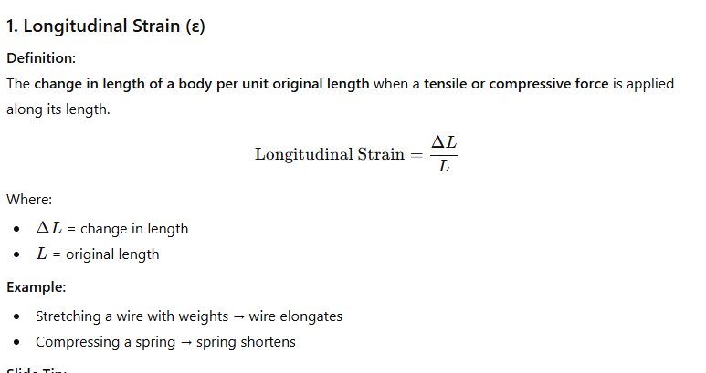
Strain

Slide 21
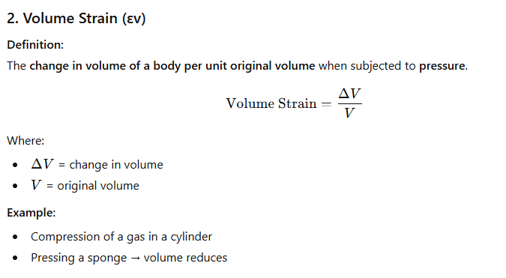
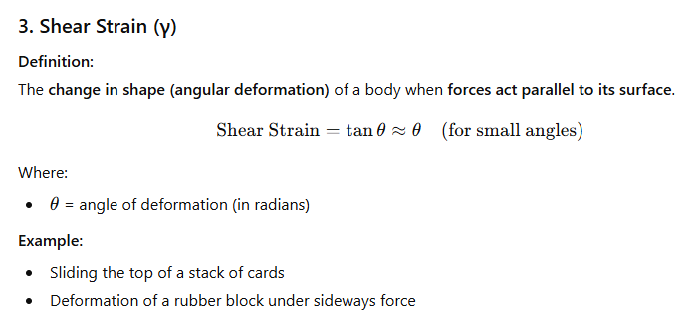

Slide 22
Modulus of Elasticity (Young’s Modulus)
The modulus of elasticity (also called Young’s modulus) is a measure of a material’s stiffness.
It tells us how much a material stretches or compresses when a force is applied as long as it stays within the elastic limit.
How hard it is to stretch a material.
Mathematically
𝑌=Stress / Strain ​
Where:
Stress =𝐹/𝐴 ​ (force per unit area)
Strain =Δ𝐿/𝐿= ​ (change in length / original length)
So,
𝑌=𝐹𝐿/𝐴Δ𝐿 ​
Unit: Pascal (Pa) or N/m²
High Young’s modulus → material is stiff (steel)
Low Young’s modulus → material is flexible (rubber)
​

Slide 23
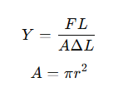
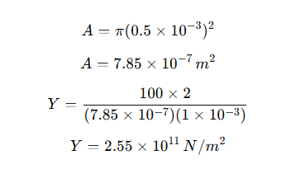

Numerical
Problem 1
A steel wire of length 2 m and radius 0.5 mm is stretched by a force of 100 N. If the extension produced is 1 mm, calculate Young’s modulus.
Given
𝐿=2 𝑚; 𝑟=0.5 𝑚𝑚=0.5×10−3 𝑚; 𝐹=100 𝑁; Δ𝐿=1 𝑚𝑚=1×10−3 𝑚
Formula
Solution
Answer

Slide 24
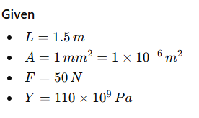
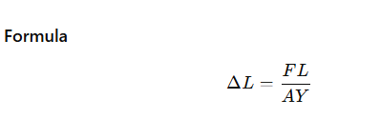
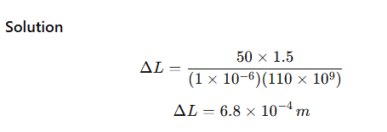
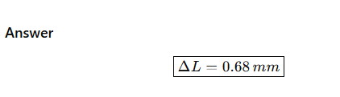
Problem 2
A copper wire of length 1.5 m and cross-sectional area 1 mm² is subjected to a force of 50 N. If Young’s modulus for copper is 110 GPa, find the extension produced.

Slide 25
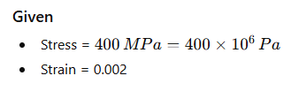
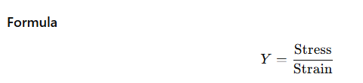
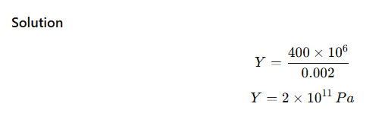

Problem 3
A wire shows a strain of 0.002 when a stress of 400 MPa is applied. Calculate Young’s modulus.

Slide 26
Problem 4
A copper wire of length 2.5m has a percentage strain of 0.012% under a tensile force. Calculate the extension in the wire
Given that, The original length is 2.5 m
Strain = △L/L = 0.012 %
Strain = 0.012/100
△L = (0.012/100) x 2.5
△L = 0.3 m

Slide 27
Problem 5
Given the deforming force as 150 N applied on a body of area of cross-section as 10 m². Calculate the stress in the body.
Solution:
Given that,
Stress = Deforming force / Area of the body
Stress = F/A
Stress = 150/10
Stress = 15 N/m²

Slide 28
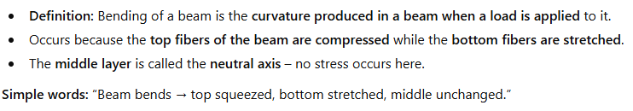
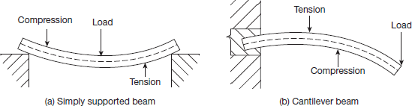
Bending of Beam
Top part of the beam → gets squeezed (compression)
Bottom part of the beam → gets stretched (tension)
Middle layer → does not change length → called neutral axis

Slide 29
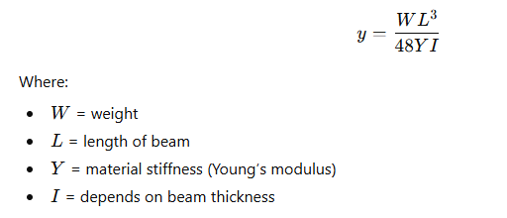
Deflection Formula
Maximum bend occurs at the middle
Beam returns to original shape if weight is small (elastic limit)
Formula to find how much it bends (deflection):

Slide 30
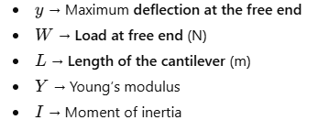
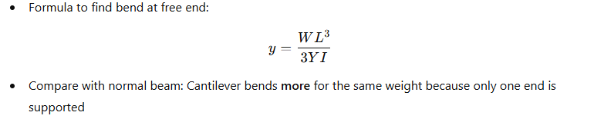
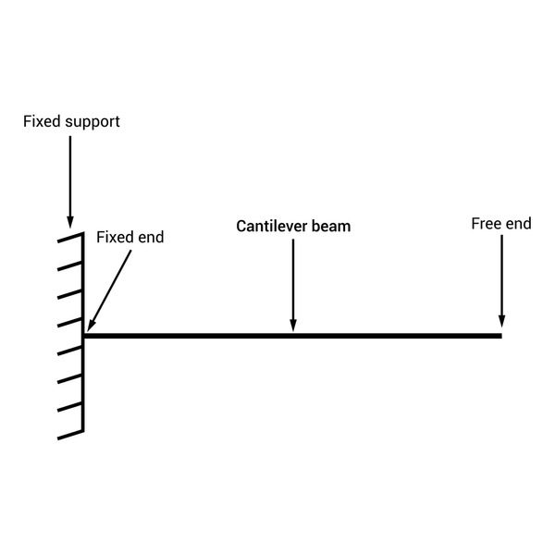
Cantilever
Cantilever, beam supported at one end and carrying a load at the other end or distributed along the unsupported portion. The upper half of the thickness of such beam is subjected to tensile stress, tending to elongate the fibers, the lower half to compressive stress, tending to crush them.

Slide 31


